Slide 1
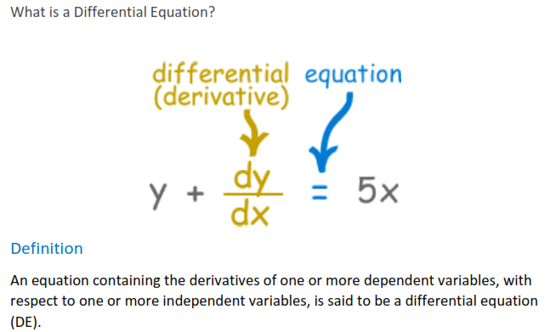

Slide 2
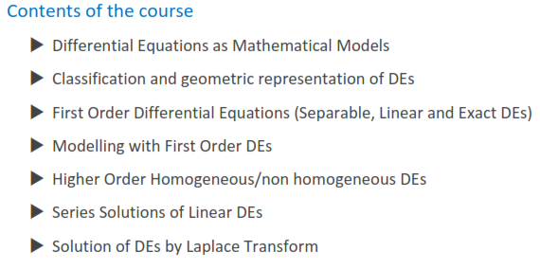

Slide 3
Why do we study this course?
The subject of differential equations is an extremely important one in mathematics and science, as well as many other branches of studies (engineering, economics, commerce) in which changes occur and in which predictions are desirable.
In most such circumstances, the systems studied come with some kind of "Natural Laws", or observations that, when translated into the language of mathematics, become differential equations.

Slide 4
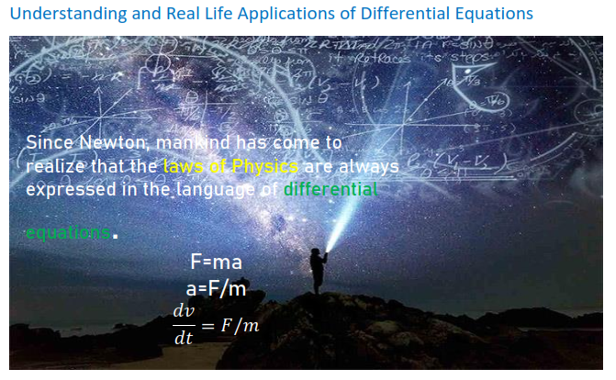

Slide 5
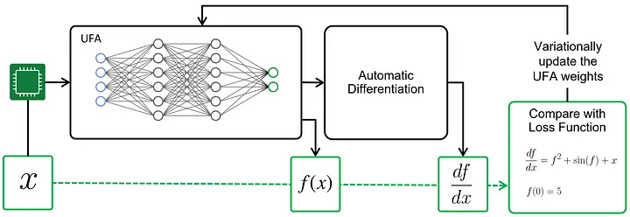
Machine Learning: ODEs have found applications in deep learning. Neural Ordinary Differential Equations (NODEs) and Continuous Normalizing Flows (CNFs) are concepts that involve the use of ODEs to model the continuous dynamics of data.

Slide 6
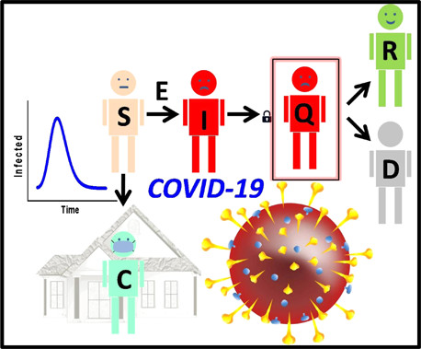
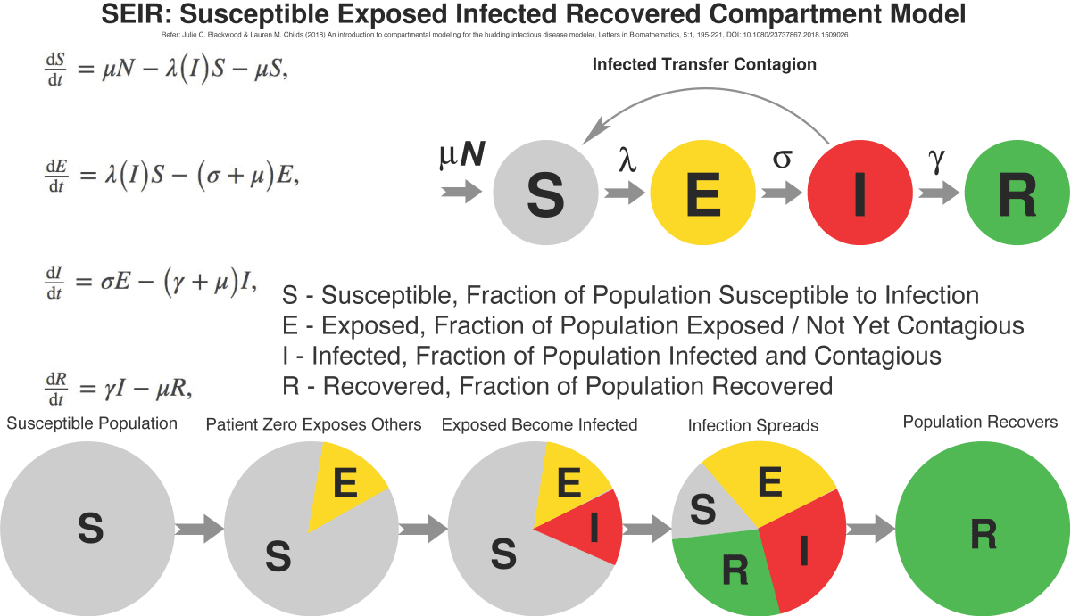
Epidemiology: ODEs are used in epidemiology to model the spread of diseases in populations. These models help in predicting the course of epidemics and designing effective intervention strategies, as seen in the SIR (Susceptible-Infectious-Recovered) model.

Slide 7
Classification by type
Ordinary differential equation:
If an equation contains only ordinary derivatives of one or more variables with respect to a single independent variable, it is said to be an ordinary differential equation (ODE).

Slide 8
Partial differential equation:
An equation involving partial derivatives of one or more dependent variables with respect to two or more independent variables is called a partial differential equation (PDE).

Slide 9
Order of Differential Equation
The order of a differential equation (either ODE or PDE) is the order of the highest derivative in the equation.

Slide 10
Degree of Differential Equation
The degree of a differential equation is the greatest exponent of the highest order derivative that appears in the equation. (The dependent variable and its derivatives should be expressed in a form free of radicals and fractions).

Slide 11
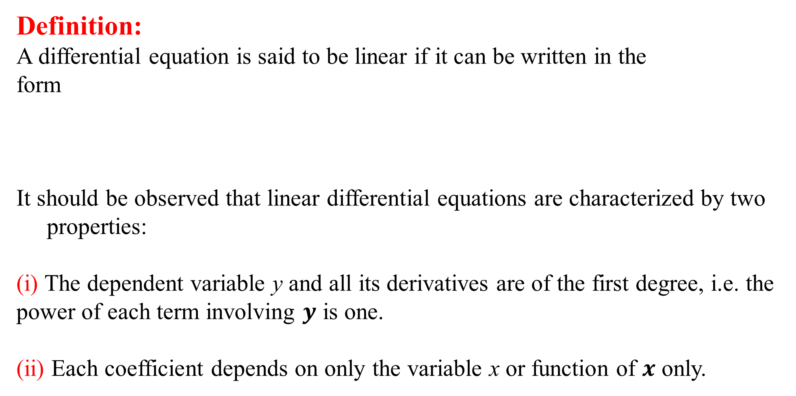
Linear and Nonlinear ODEs
Definition:
A differential equation is said to be linear if it can be written in the
form
It should be observed that linear differential equations are characterized by two properties:
(i) The dependent variable y and all its derivatives are of the first degree, i.e. the power of each term involving $y$ is one.
(ii) Each coefficient depends on only the variable x or function of $x$ only.

Slide 12
Linear and Nonlinear ODEs

Slide 13
Examples

Slide 16

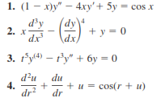
Practice Questions

Slide 17
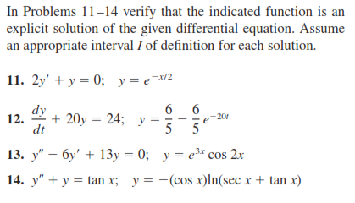

Slide 18
Practice Questions
Exercise 1.1
Questions 1-18
A First Course in Differential Equations with Modelling Applications
By Dennis G. Zill [10th Edition]

